Slide 1
Schema Refinement

Slide 2
Schema Refinement
Relational schema refinement is a process used to improve the design of a database schema to reduce redundancy and eliminate anomalies. Here are the key steps involved:
Identify Functional Dependencies (FDs): These are constraints between two sets of attributes in a relation. For example, if attribute A determines attribute B, then B is functionally dependent on A.
Decompose Relations: Based on the identified FDs, decompose the relations into smaller, more manageable tables. This helps in reducing redundancy and avoiding anomalies like update, insertion, and deletion anomalies.
Normalization: This involves organizing the attributes and relations of a database to minimize redundancy. The process typically involves several normal forms (1NF, 2NF, 3NF, BCNF, etc.), each with specific rules to follow12.
Check for Lossless Join and Dependency Preservation: Ensure that the decomposition of relations does not result in loss of information and that all functional dependencies are preserved.

Slide 3
Schema Refinement
Guidelines for the Relational Schema
Functional dependencies
Normalization
Boyce Code Normal form
Multi valued dependency and Fourth Normal form
Join dependency and Fifth Normal form

Slide 4
Schema Refinement
Informal Design Guidelines for Relational Schema.
The Schema Refinement refers to refine the schema by using some technique.
The best technique of schema refinement is decomposition.
Normalization means “split the tables into small tables which will contain less number of attributes in such a way that table design must not contain any problem of inserting, deleting, updating anomalies and guarantees no redundancy”.
Normalization or Schema Refinement is a technique of organizing the data in the database.
It is a systematic approach of decomposing tables to eliminate data redundancy and undesirable characteristics like Insertion, Update and Deletion Anomalies.
Redundancy: refers to repetition of same data or duplicate copies of same data stored in different locations.
Anomalies: Anomalies refers to the problems occurred after poorly planned and normalized databases where all the data is stored in one table which is sometimes called a flat file database.

Slide 5
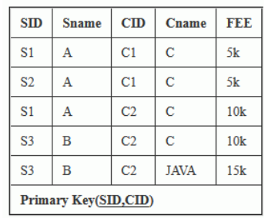
Anomalies
Anomalies refers to the problems occurred after poorly planned and un-normalized databases where all the data is stored in one table which is sometimes called a flat file database. Let us consider such type of schema.

Slide 6
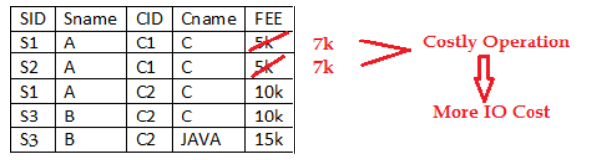
Insertion anomalies : It may not be possible to store some information unless some other information is stored as well.
Redundant storage: some information is stored repeatedly
Update anomalies: If one copy of redundant data is updated, then inconsistency is created unless all redundant copies of data are updated.
Deletion anomalies: It may not be possible to delete some information without losing some other information as well.
Problem in updation / updation anomaly – If there is updation in the fee from 5000 to 7000, then we have to update FEE column in all the rows, else data will become inconsistent.

Slide 7
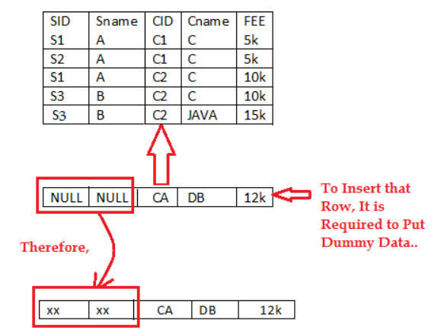
Insertion Anomaly and Deletion Anomaly- These anomalies exist only due to redundancy, otherwise they do not exist.
Insertion Anomalies: New course is introduced CA, But no student is there who is having CA subject.

Slide 8
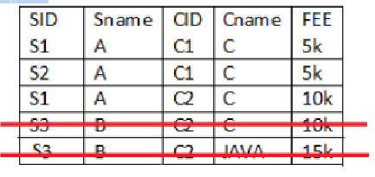
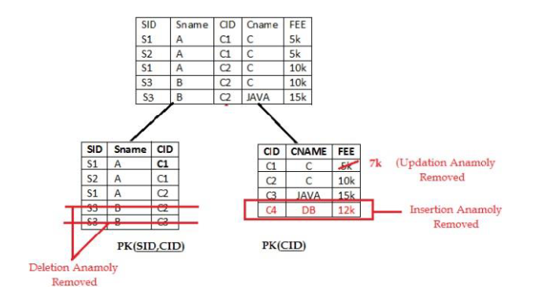
Deletion Anomaly: Deletion of S3 student cause the deletion of course. Because of deletion of some data forced to delete some other useful data.
Solutions To Anomalies : Decomposition of Tables – Schema Refinement,

Slide 9
Decomposition
The only way to avoid the repetition-of-information problem in the relation schema is to decompose it into two or more schemas.
Not all decompositions are good. Suppose we decompose
employee(ID, name, street, city, salary) into
employee1 (ID, name)
employee2 (name, street, city, salary)
The problem arises when we have two employees with the same name.
Types of decomposition:
Lossy Decomposition
Lossless Decomposition

Slide 10
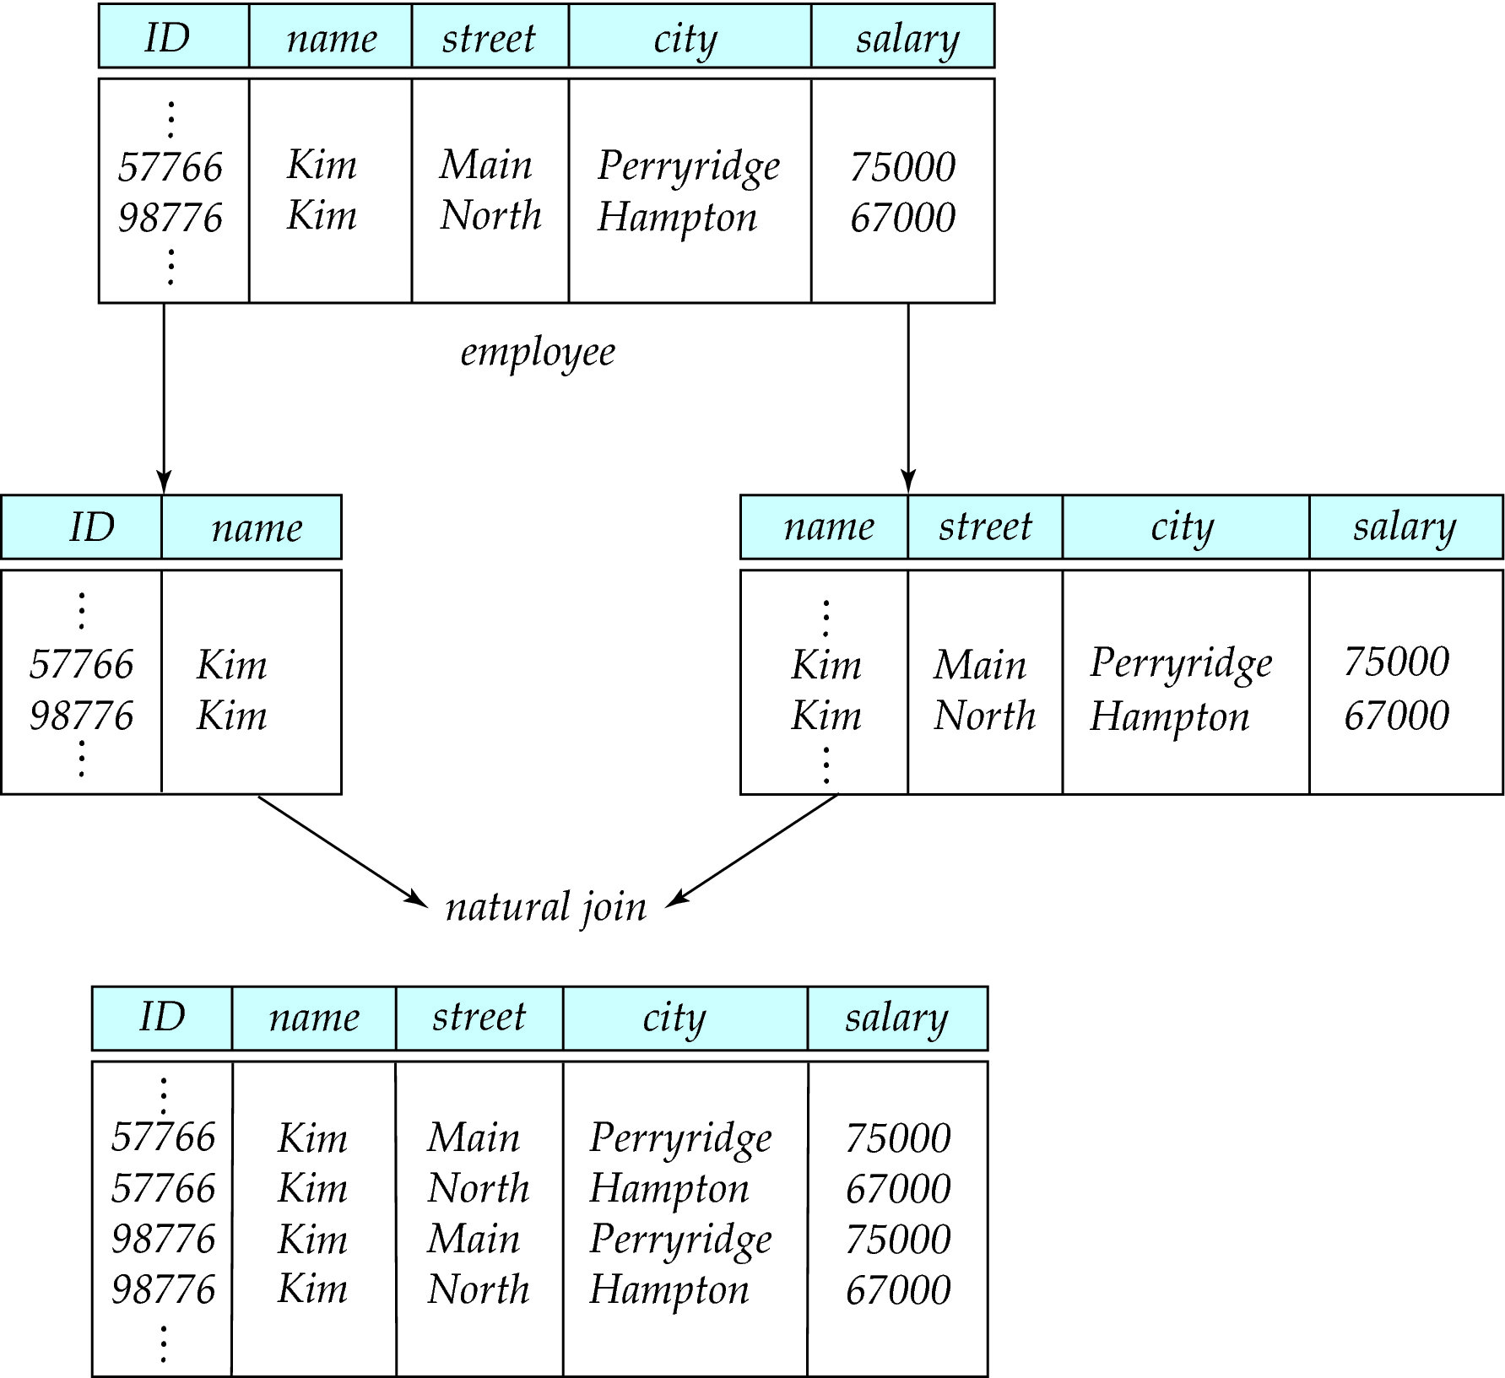
Lossy Decomposition

Slide 11
Lossless Decomposition
Let R be a relation schema and let R₁ and R₂ form a decomposition of R . That is R = R₁ U R₂
We say that the decomposition is a lossless decomposition if there is no loss of information by replacing R with the two relation schemas R₁ U R₂
Formally,
∏ _{R1} (r) ∏ _{R2} (r) = r
And, conversely a decomposition is lossy if
r ⊂ ∏ _{R1} (r) ∏ _{R2} (r) = r

Slide 12
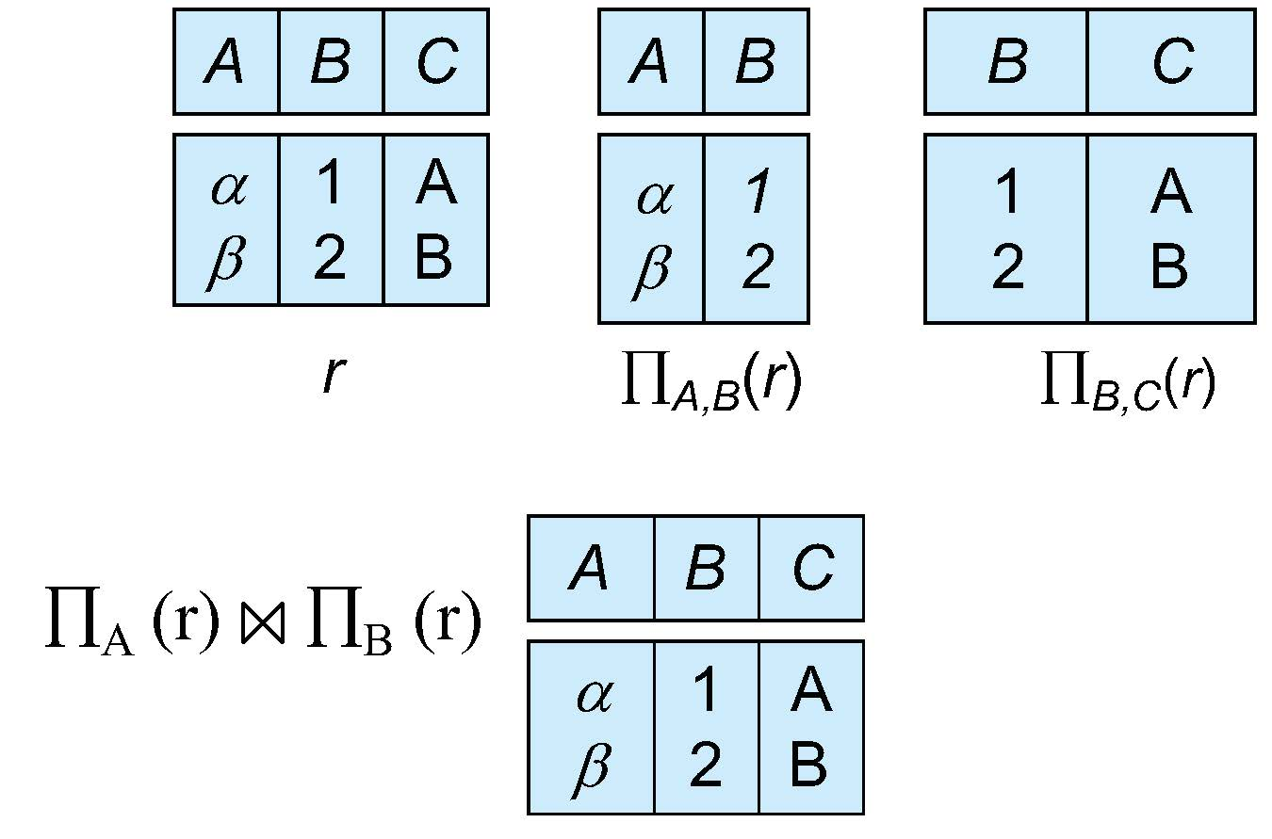
Example of Lossless Decomposition
Decomposition of R = (A, B, C) R₁ = (A, B) R₂ = (B, C)

Slide 13
Schema Refinement
Informal Design Guidelines for Relational Schema
1.Semantics of the Attributes
2.Reducing the Redundant Value in Tuples.
3.Reducing Null values in Tuples.
4.Dissallowing spurious Tuples.

Slide 14
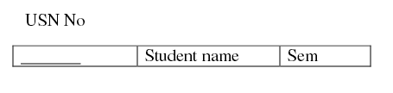
Schema Refinement
1.Semantics of the Attributes
Whenever we are going to form relational schema there should be some meaning among the attributes. This meaning is called semantics.
This semantics relates one attribute to another with some relation.

Slide 15

Schema Refinement
2. Reducing the Redundant Value in Tuples
Mixing attributes of multiple entities may cause problems
Information is stored redundantly wasting storage
Problems with update anomalies
Insertion anomalies
Deletion anomalies
Modification anomalies

Slide 16
Schema Refinement
Informal Design Guidelines for Relational Schema
2. Reducing the Redundant Value in Tuples
Here whenever if we insert the tuples there may be ‘N’ students in one department, so Dept No, Dept Name values are repeated ‘N’ times which leads to data redundancy.

Slide 17
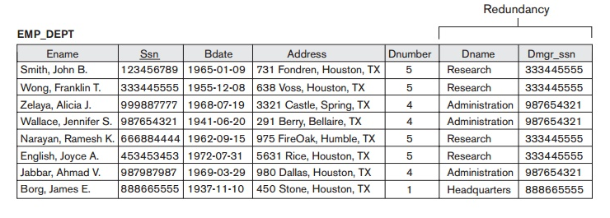

Slide 18
Schema Refinement
Informal Design Guidelines for Relational Schema
2. Reducing the Redundant Value in Tuples
If we delete the last student of a dept, then whole information about that department will be deleted.
Another problem is update anamolies i.e. if we insert new dept that has no students.
If we change the value of one of the attributes of a particular table the we must update the tuples of all the students belonging to that dept else Database will become inconsistent.
Relations should be designed such that their tuples will have as few NULL values as possible
Attributes that are NULL frequently could be placed in separate relations (with the primary key )

Slide 19
Schema Refinement
Informal Design Guidelines for Relational Schema
4. Dissallowing spurious Tuples
Emp_ Loc Emp_ Proj
Ename | Ploc
RAJA | SJT
KUMAR | TT
SIVA | SJT
…..
SSN | Pno | P Name | Ploc
101 | 44 | A | SJT
102 | 45 | B | TT
103 | 46 | C | SJT
….

Slide 20
Schema Refinement
Informal Design Guidelines for Relational Schema
4. Dissallowing spurious Tuples
SSN | Pno | P Name | EName | Ploc
101 | 44 | A | RAJA | SJT
102 | 45 | B | KUMAR | TT
103 | 46 | C | RAJA | SJT
….

Slide 21
Schema Refinement
Normalization
Data analysis technique to design a Database system
Abnormal data to normal data
Properties
No redundancy
No update anomaly

Slide 22
Schema Refinement
Normalization
Functional Dependencies
Finding the key attribute

